Slide 1
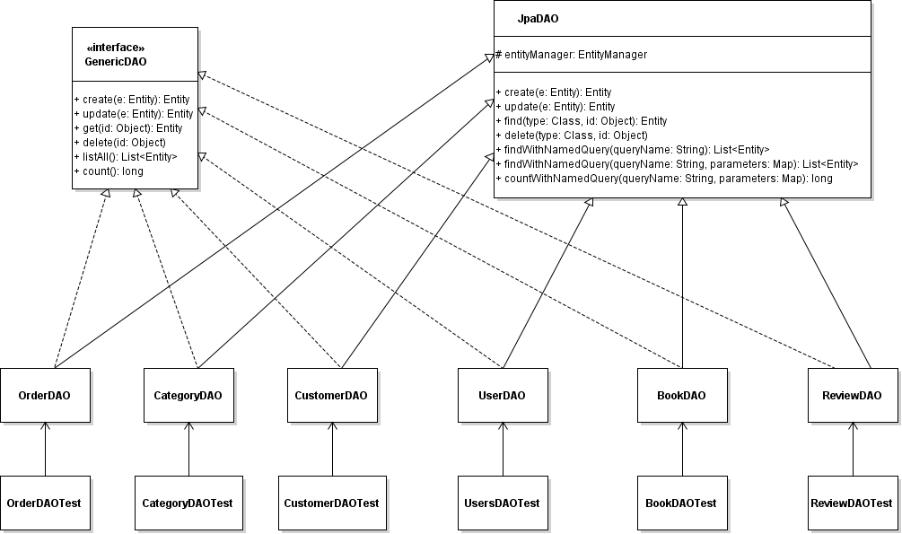
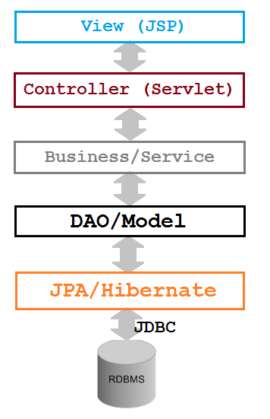
Coding DAO Classes

Slide 2
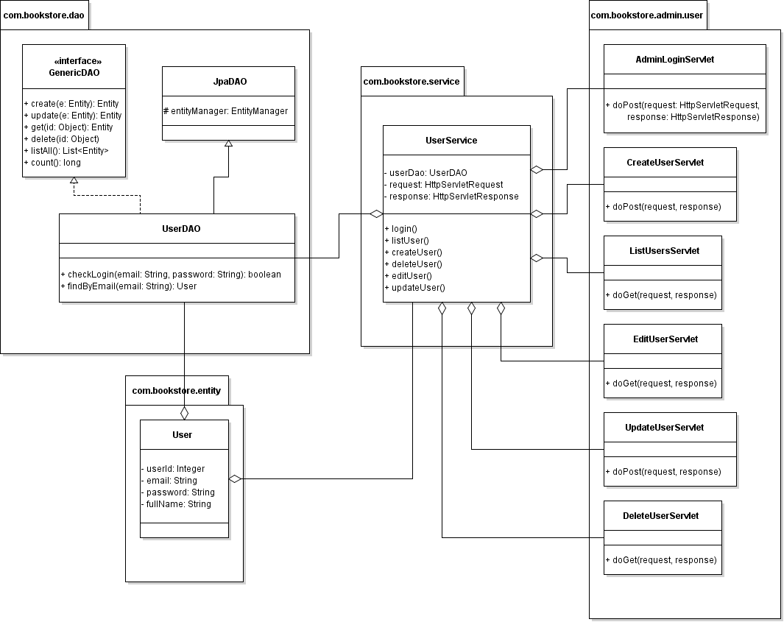

Slide 3
Coding DAO Classes
Code GenericDAO interface
Code JpaDAO class
Code UsersDAO class
Code UsersDAOTest with JUnit

Slide 4
Introduction to JUnit
JUnit is one of the most popular unit testing frameworks for Java development
Unit testing is important in Test Driven Development
All IDEs and build tools include support for JUnit.
JUnit is the default testing library in Eclipse

Slide 5
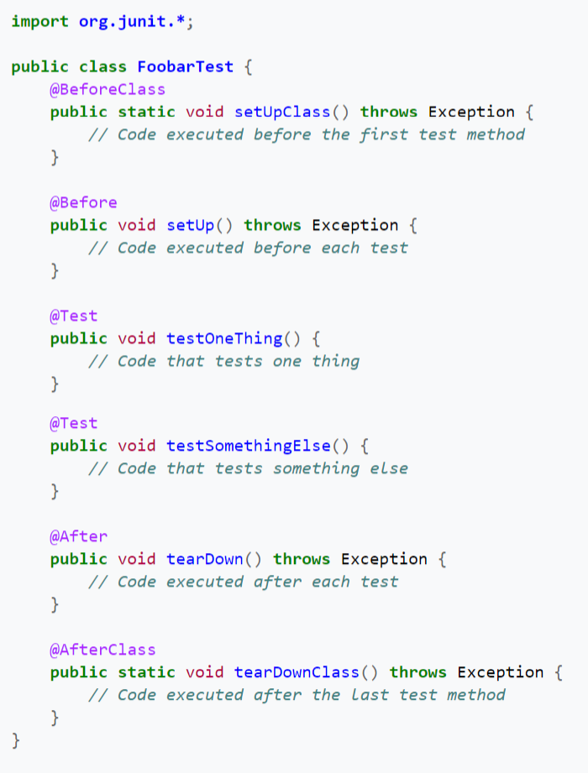
JUnit 4:

Slide 6
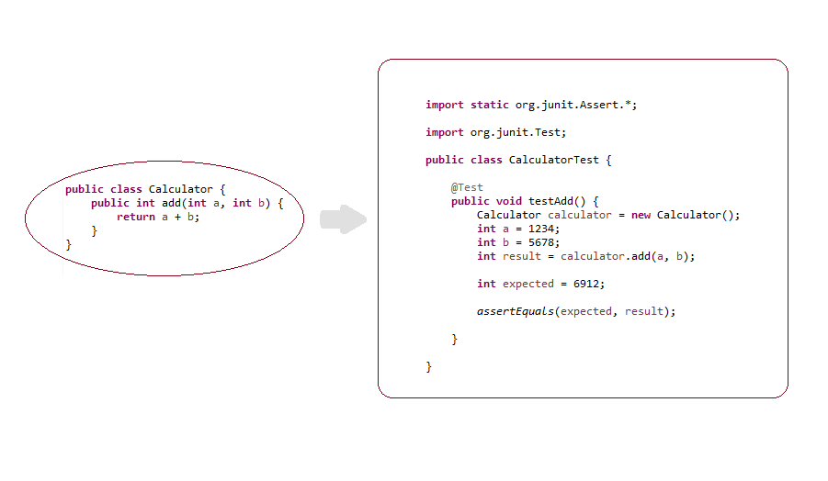
Example of a Test Class

Slide 7
Assertion methods in JUnit
assertEquals(expectedValue, actualValue)
assertNotEquals(unexpectedValue, actualValue)
assertFalse(condition)
assertTrue(condition)
assertNull(object)
assertNotNull(object)

